Slide 1
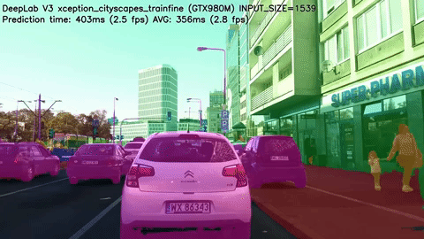
Image Segmentation

Slide 2
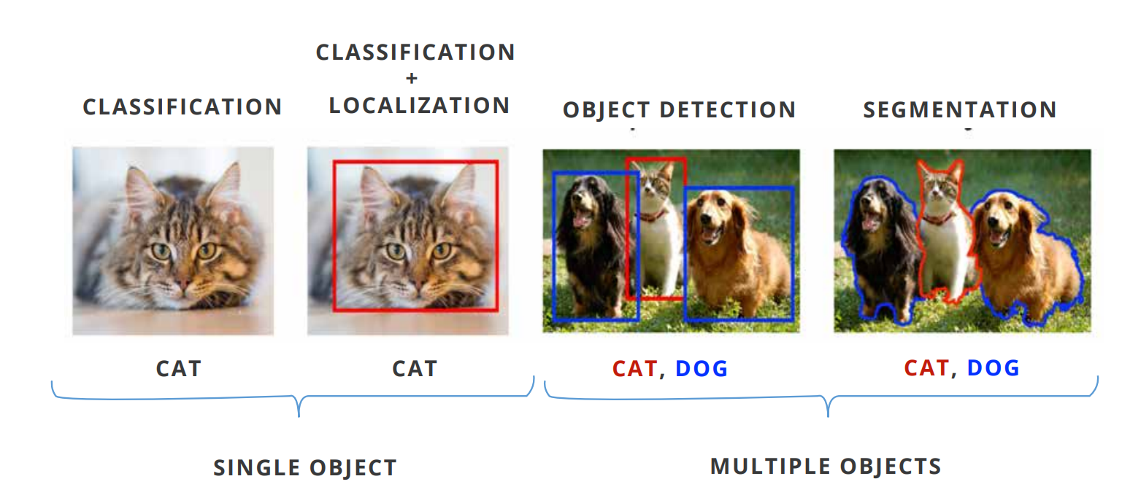
Computer Vision

Slide 3
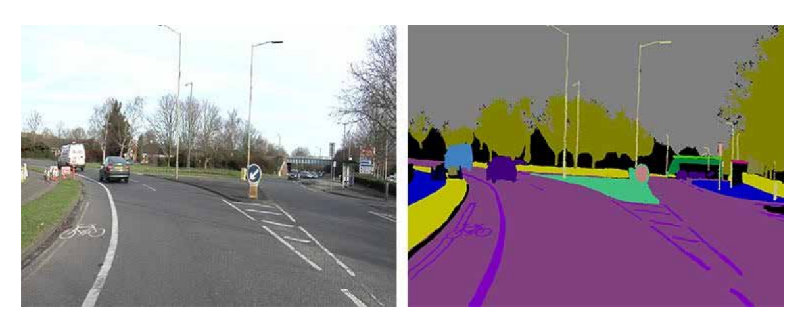
WHAT IS IMAGE SEGMENTATION
The problem to classify the pixels in an image and then segment the image to by drawing an outline around objects is called Segmentation

Slide 4
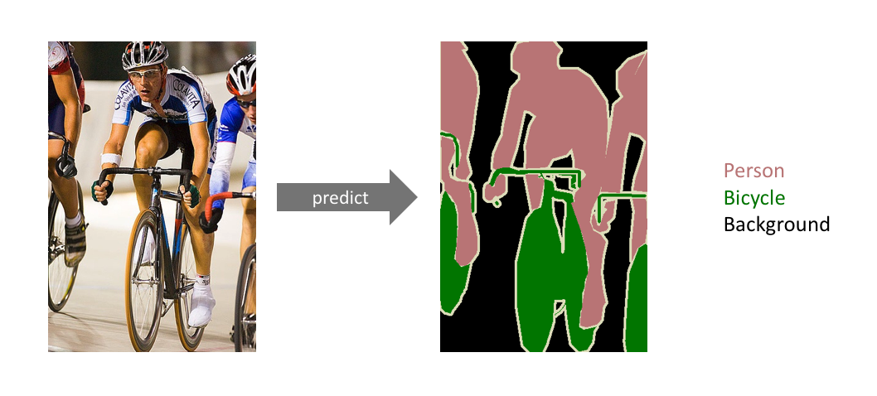
Image Segmentation

Slide 5
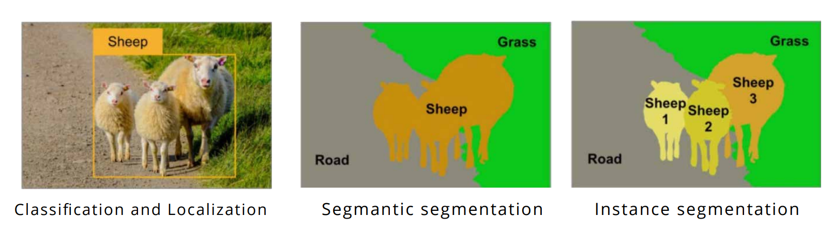
TYPES OF SEGMENTATION
Semantic Segmentation masks road, sheep and grass. It can identify different objects.
Instance Segmentation masks different sheep. It can identify different instances of an object.

Slide 6
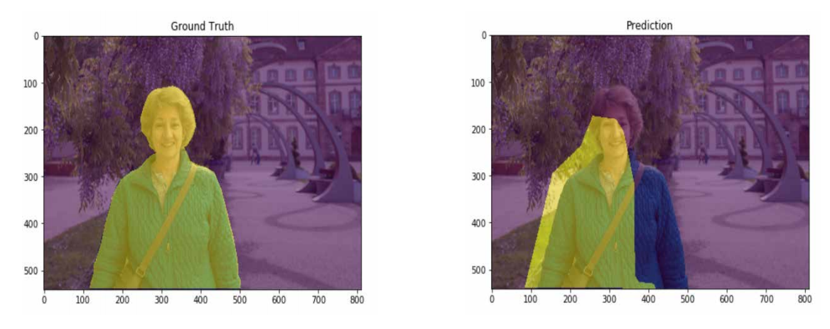
EVALUTION OF IMAGE SEGMENTATION MODELS
In Segmentation we want to predict the class of every pixel in the image.
The Intersection Over Union(IoU) is a metric which tells the percent overlap between the target mask and predicted output.

Slide 7
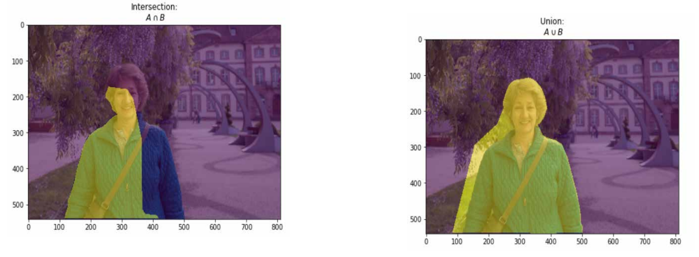
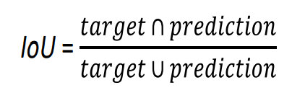
WHAT IS INTERSECTION OVER UNION?
IOU metric measures the pixels common between the target and the predicted masks divided by the total number of pixels present across both masks.

Slide 8
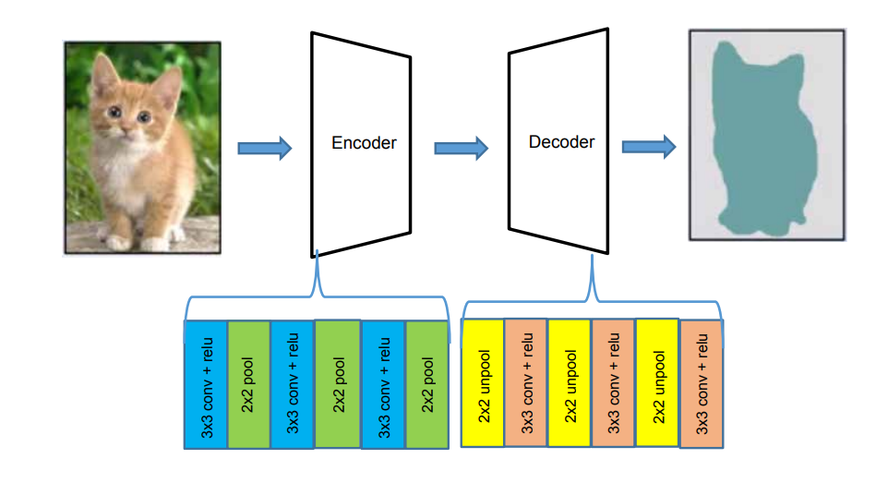
ENCODER DECODER ARCHITECTURE
This method produces more accurate image segmentation.

Slide 9
ENCODER DECODER ARCHITECTURE
The encoder and decoder layers are of same size.
Encoder is used to extract the features.
The decoder will use the features to create mask on the original image.

Slide 10
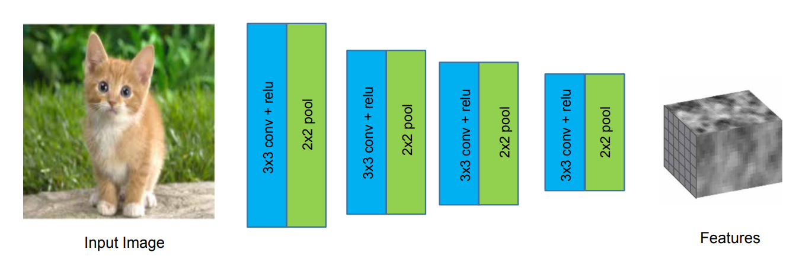
Encoder

Slide 11
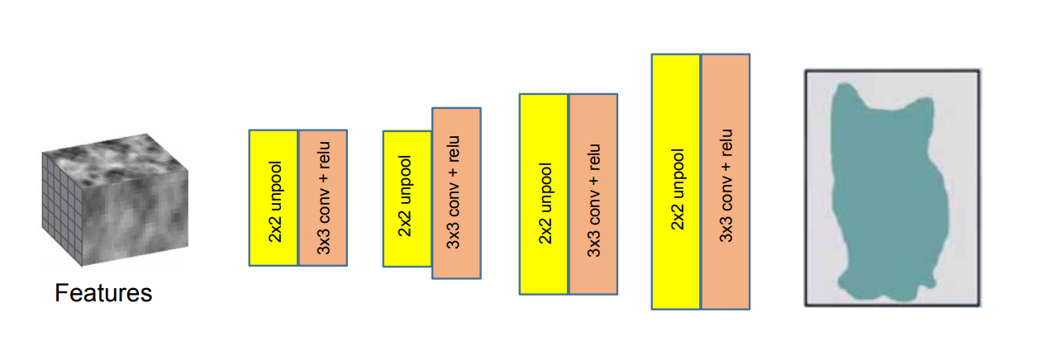
Decoder

Slide 12
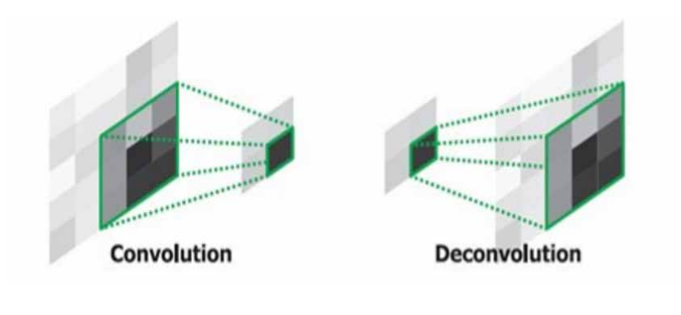
WHAT IS TRANSPOSE CONVOLUTION LAYER
Convolution is the process to get the output size smaller. Deconvolution or Transpose Convolution is the process when we want to upsample image to get larger size.

Slide 13
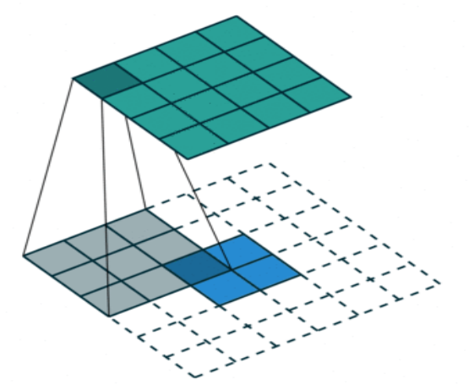
HOW DOES DECONVOLUTION WORKS
Blue is the input, Grey is the 3x3 filter, Green is the output. Stride is 1. The calculation is same as for convolution.
So with an input of 2x2 and a filter size of 3x3, we can obtain a bigger image of size 4x4 with stride as 1.

Slide 14
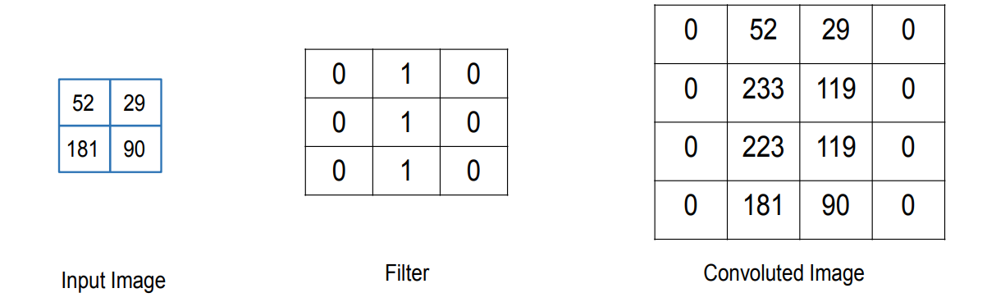
MATHS BEHIND DECONVOLUTION
This is how we obtain a 4x4 image, when we perform deconvolution on 2x2 image with a 3x3 filter.

Slide 15
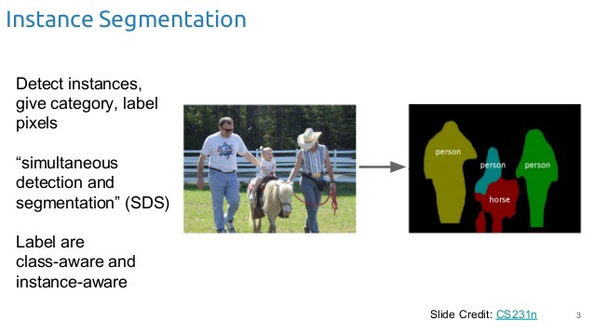

Slide 16
Unet
UNet Architecture has 3 parts:
The Contracting/Downsampling Path
Bottleneck
The Expanding/Upsampling Path

Slide 17
Unet
Downsampling Path:
It consists of two 3x3 convolutions (unpadded convolutions), each followed by a rectified linear unit (ReLU) and a 2x2 max pooling operation with stride 2 for downsampling.
At each downsampling step we double the number of feature channels.
Upsampling Path:
Every step in the expansive path consists of an upsampling of the feature map followed by a 2x2 convolution (“up-convolution”), a concatenation with the correspondingly feature map from the downsampling path, and two 3x3 convolutions, each followed by a ReLU.

Slide 18

Unet

